Slide 1
Questions from JM Kim (Student ID: 2022315690)
About what you talked about in today's lecture, you said we could simplify the state graph with the state table.
I'm wondering how we get the state table below.
Also, why does the next state from H to P point to A?
Table 15-1: State Table for Sequence Detector Mealy 0101 or 1001
Input Sequence | Present State | Next State |  | Present Output
 |  | X=0 | X=1 | X=0 | X=1
reset | A | B | C | 0 | 0
0 | B | D | E | 0 | 0
1 | C | F | G | 0 | 0
00 | D | H | I | 0 | 0
01 | E | J | K | 0 | 0
10 | F | L | M | 0 | 0
11 | G | N | P | 0 | 0
000 | H | A | A | 0 | 0
001 | I | A | A | 0 | 0
010 | J | A | A | 0 | 1
011 | K | A | A | 0 | 0
100 | L | A | A | 0 | 1
101 | M | A | A | 0 | 0
110 | N | A | A | 0 | 0
111 | P | A | A | 0 | 0

Slide 2
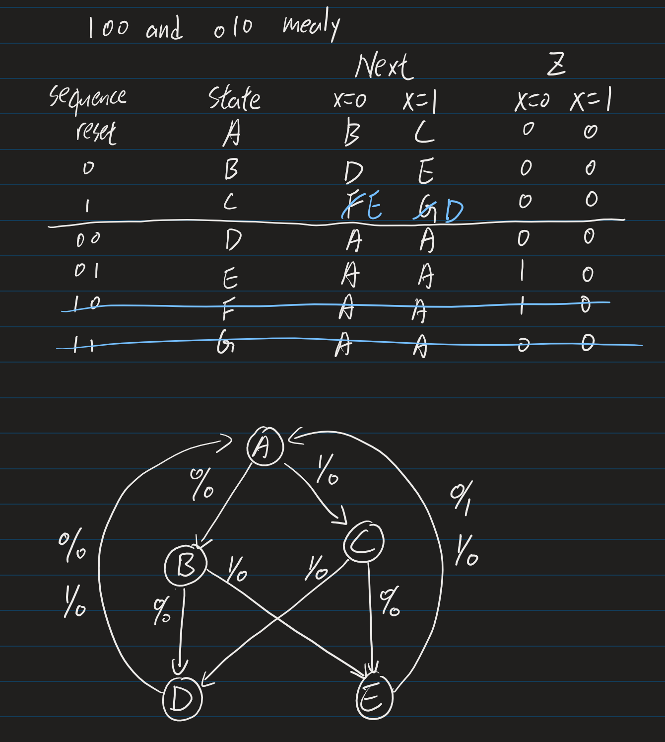
Questions from JM Kim (Student ID: 2022315690)
The state graph I draw is capable of inputs like 010110100, but it can't deal with inputs like 10010.
I'm wondering what's the problem of it.

Slide 3
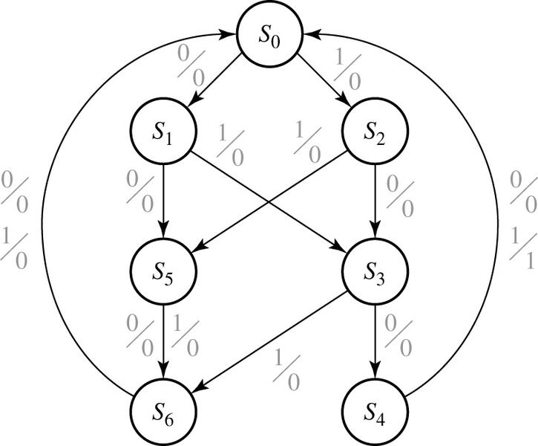
15.1 Elimination of Redundant States
Example: Sequence Detector ㅡ 14.3 Mealy 0101 or 1001
X = | 0101 | 0010 | 1001 | 0100
Z = | 0001 | 0000 | 0001 | 0000
state | sequence received
S₀ S₁ S₂ S₃ S₄ S₅ S₆ | Reset 0 1 01 or 10 010 or 100 two inputs received, no 1 output is possible three inputs received, no 1 output is possible

Slide 4
Questions from JM Kim (Student ID: 2022315690)
State Table for Sequence Detector Mealy 100 or 010 MOVING WINDOW
Input Sequence | Present State | Next State |  | Present Output
 |  | X=0 | X=1 | X=0 | X=1
reset | A | B | C | 0 | 0
0 | B | D B | E | 0 | 0
1 | C | F | G C | 0 | 0
00 | D | - | - | - | -
01 | E | F | C | 1 | 0
10 | F | B | E | 1 | 0
11 | G | - | - | - | -

Slide 5
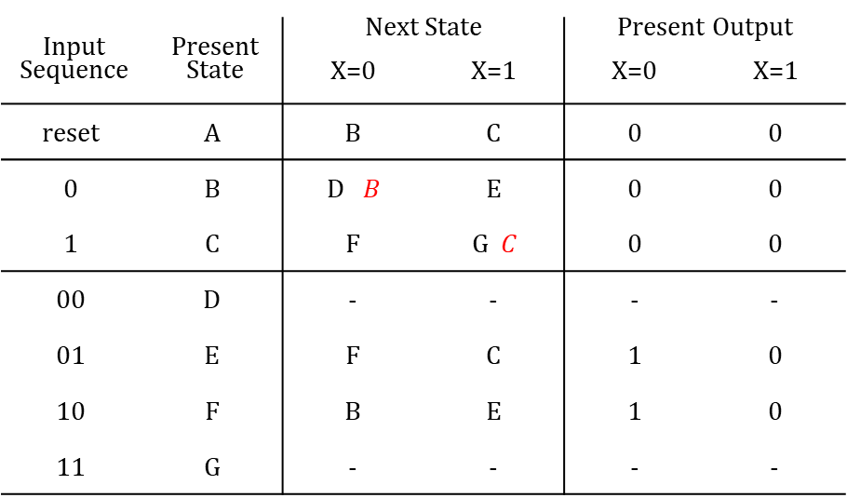
Questions from JM Kim (Student ID: 2022315690)
State Graph for Sequence Detector Mealy 100 or 010 MOVING WINDOW
S
A
0/0
1/0
B
S
1/0
0/0
C
?
1/0
?
0/0
1/0
?
S
0/1
0/1
E
F
1/0

